Slide 1

Weakly Supervised Object Localization (WSOL) Overview
-------------------------------------------------------------------------------------------------------------------------------------
CIS607 Computer Vision and
Deep Learning Seminar
-------------------------------------------------------------------------------------------------------------------------------------
Tyler Newton

Slide 2
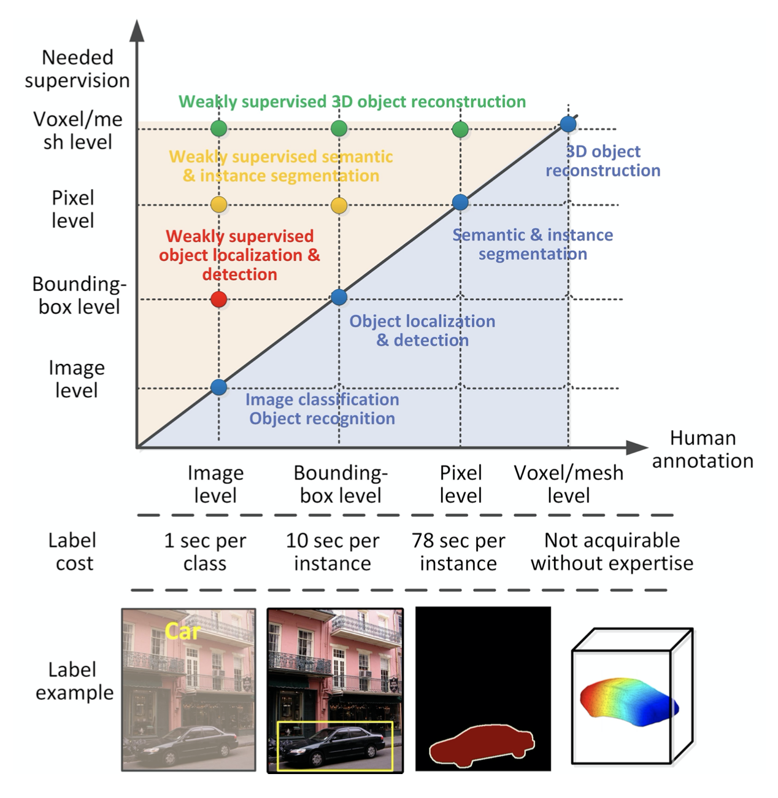
Weakly Supervised Object Localization (WSOL)
-training data are class labels
(image-level labels)
-no information on location
figure credit: Zhang et al. 2021
Notes:
annotation is lower degree of info than output

Slide 3
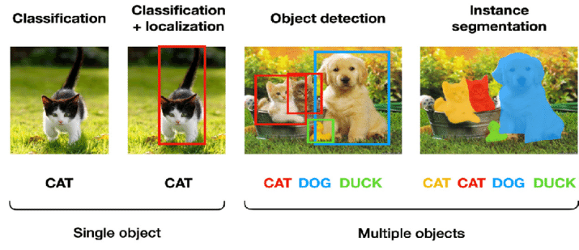
Weakly Supervised Object Localization (WSOL)
figure credit: Kang et al. 2020
Notes:
annotation is lower degree of info than output

Slide 4
Weakly Supervised Object Localization (WSOL)
ill-posed
input: image-level
output: instance-level
figure credit: Kang et al. 2020
Notes:
annotation is lower degree of info than output

Slide 5

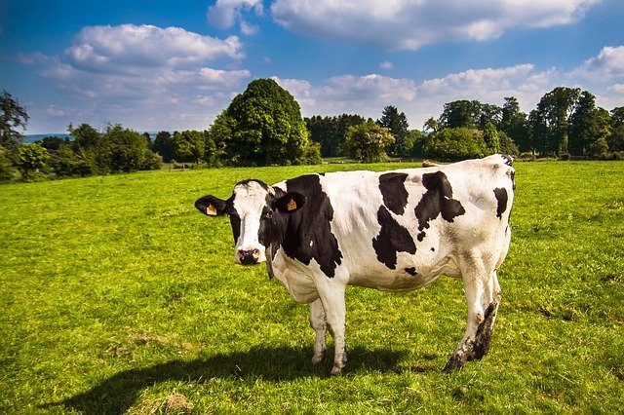
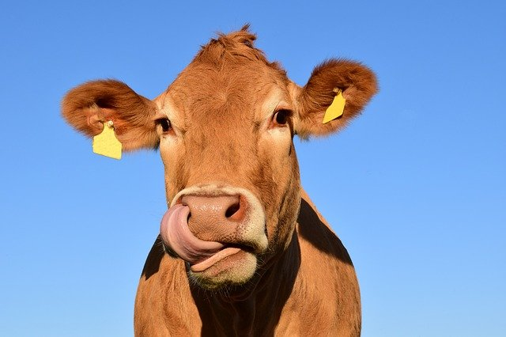

Challenges of WSOL
The usual suspects:
clutter
intra-class variance
occlusion
Mapping from class to location:
part vs whole
background vs object
concurrence
Notes:
like viewpoint, scale, aspect ratio

Slide 6
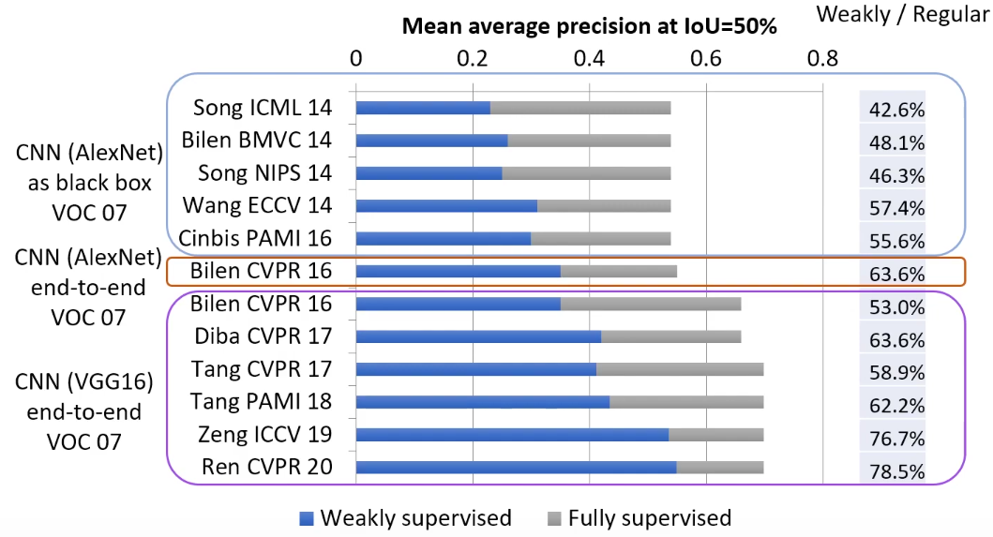
Motivation of WSOL
Save labeling time at the expense of performance.
figure credit: Zhang et al. 2021
figure credit: Bilen ECCV 2020
Notes:
like viewpoint, scale, aspect ratio

Slide 7
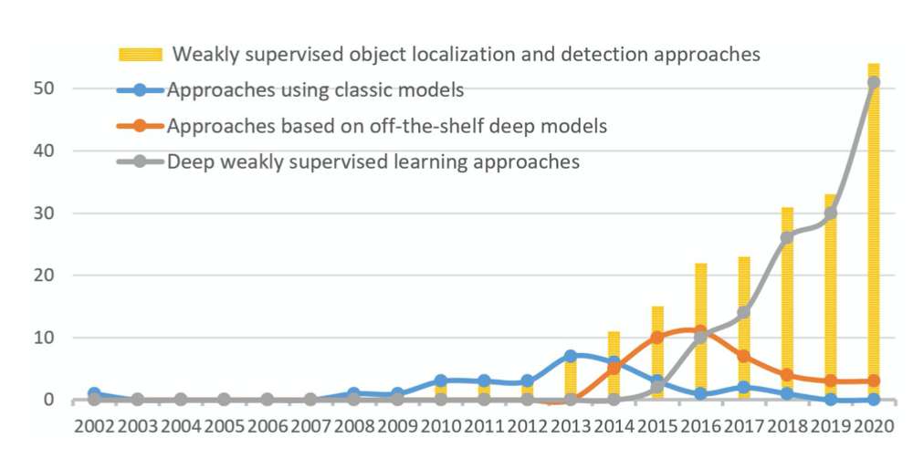
Three main frameworks
classic approaches (feature extraction)
clever initialization methods
clever refinement methods
OTS feature representations
pre-trained deep features
inherent cues in deep models
deep learning frameworks
single-network
multi-network
figure credit: Zhang et al. 2021

Slide 8
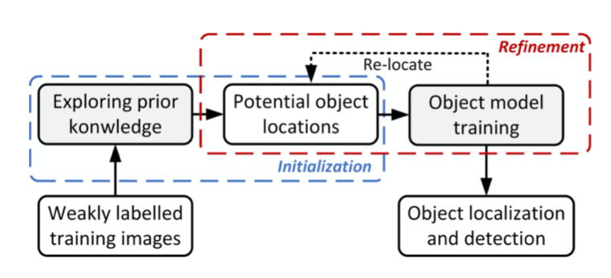
Classic approaches
figure credit: Zhang et al. 2021
Initialize 2. Refine 3. Detect
Initialization of region proposals:
selective search (van de Sande, ICCV 2011)
graphs (Song, ICML 2014)
negative mining (Siva, CVPR 2013)
etc., some type of information cue on candidate object regions
Refine:
score region proposals in some way
HOG, SIFT, etc.
Deformable Parts Model, SVM
Notes:
mine reliable instance samples

Slide 9
Classic approaches
figure credit: Zhang et al. 2021
Initialize 2. Refine 3. Detect
Initialization of region proposals:
selective search (van de Sande, ICCV 2011)
graphs (Song, ICML 2014)
negative mining (Siva, CVPR 2013)
etc., some type of information cue on candidate object regions
Refine:
score region proposals in some way
HOG, SIFT, etc.
Deformable Parts Model, SVM
The building blocks of other models
Notes:
mine reliable instance samples

Slide 10
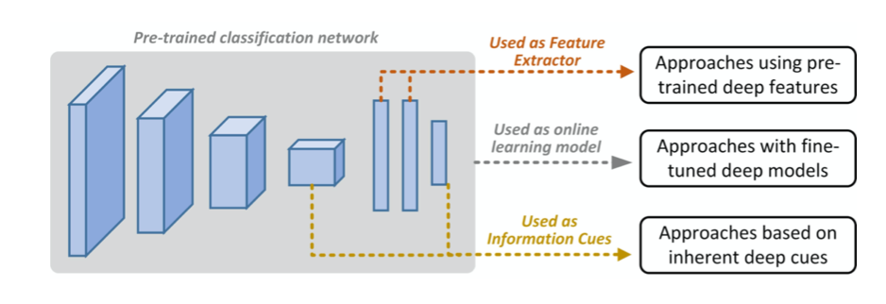
Feature representations from off-the-shelf models
Pre-trained deep features
use pre-trained models as feature extractors
Gonthier 2018, Zadrija CVIU 2018, etc.
Inherent cues in deep models
network layer activations and semantic scores
Li ISPRS 2018, Wilhelem DICTA 2017, etc.
Fine-tuned deep models
tune OTS models during weakly supervised learning
Zhang IJCV 2019, Shi ICCV 2017, Singh CVPR 2016, etc.
figure credit: Zhang et al. 2021

Slide 11
End-to-end deep weakly supervised learning
Single-network training
object regions from end-to-end learning via layers for instance inference and propagation of image labels
outputs vary 🧐: semantic scores (Wu, Bilen), CAM maps (Zhou), bounding boxes, point
Huang NIPS 2020, Shen CVPR 2020, Mai CVPR 2020, Jiang ICCV 2019, … , many others…, Wu CVPR 2015, …
Multi-network training (latest, best performance)
one network to mine initial object regions
another network for detection via MIL framework
sometimes another final object detection network (Fast[er] RCNN)
Zhang CVPR 2020, Zhong ECCV 2020m Kosugi ICCV 2019, …, Zhang TGRS 2016, etc.

Slide 12
Evaluation metrics
via PASCAL VOC, ImageNet, and CUB datasets:
CorLoc metric – bounding box with highest class score has >= 50% overlap
with ground-truth bounding box (requires a ground-truth, but
remember this is WSOL)
mAP metric – mean IOU if IOU with ground-truth is > 50%
Other metrics: GT Loc, Top-1 Loc, Top-5 Loc

Slide 13
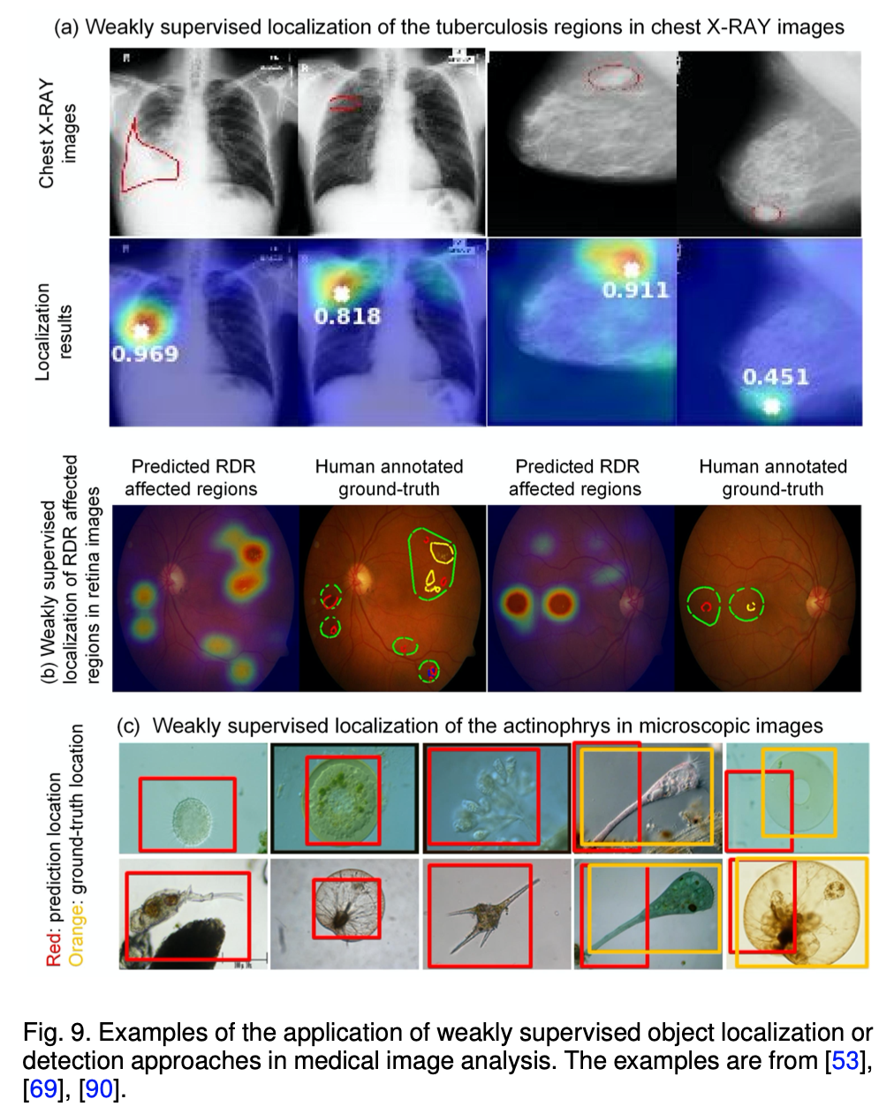
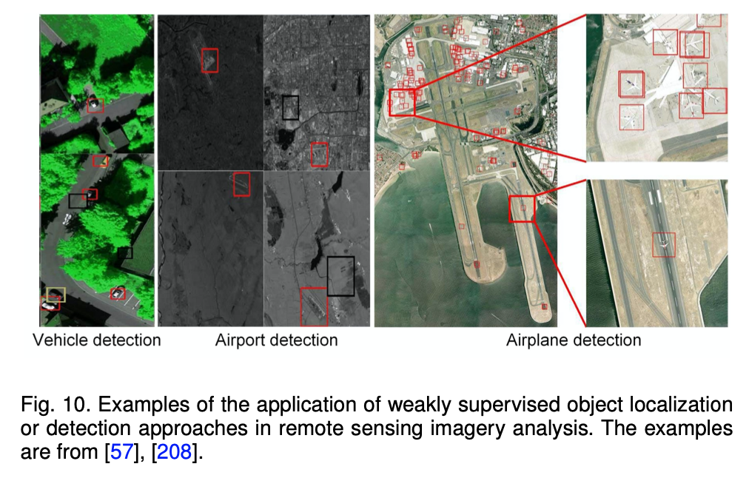
Use cases
figure credits: Zhang et al. 2021

Slide 14
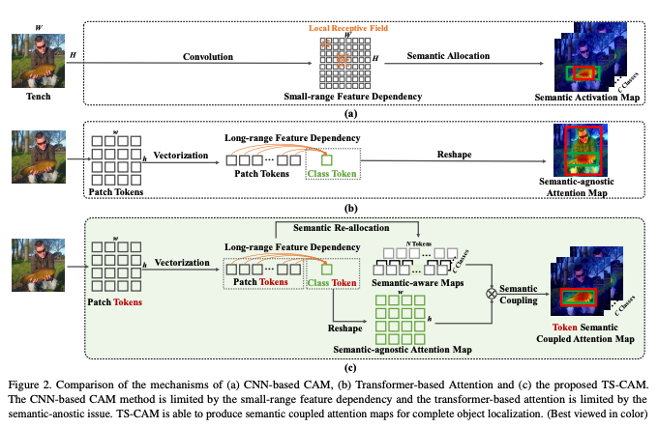
CAM methods are popular
CAM on OTS CNN models:
struggle with global cues
convolutions produce localized receptive fields leading to partial activation
Layer-CAM (Jiang et al. 2021) try to solve this by sampling shallow layers
Transformers to the rescue:
TS-CAM (Gao et al. 2021) token semantic
coupled attention maps via visual
transformer

Slide 15
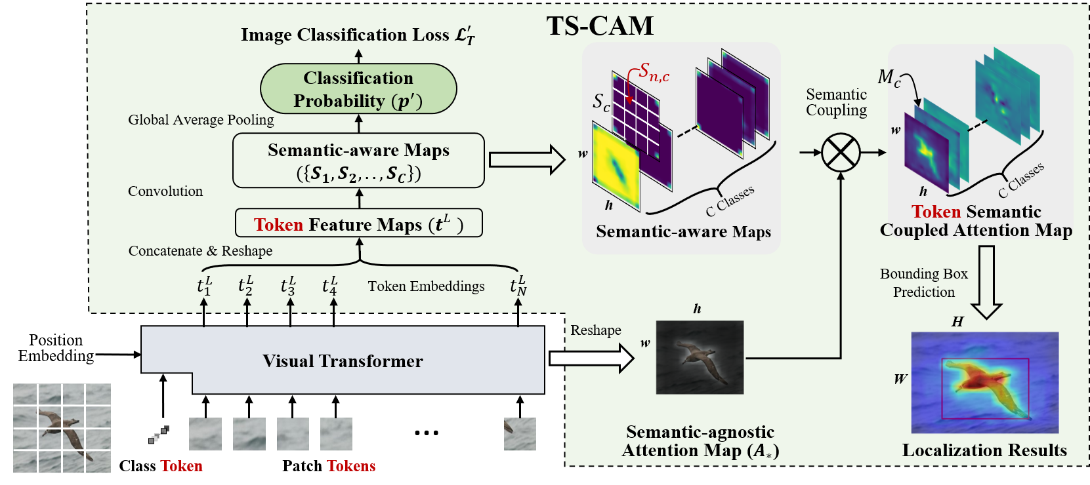
TS-CAM: Token Semantic Coupled Attention Map for Weakly Supervised Object Localization
https://github.com/vasgaowei/TS-CAM

Slide 16
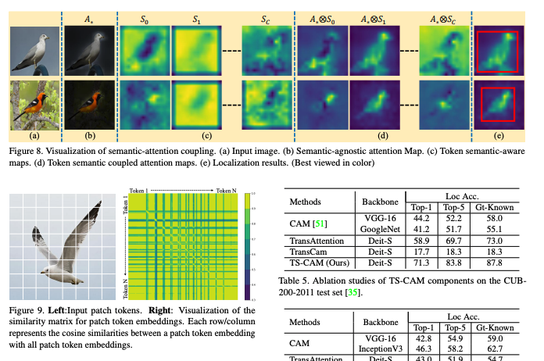
TS-CAM: Token Semantic Coupled Attention Map for Weakly Supervised Object Localization
figure credits: Gao et al. 2021

Slide 17
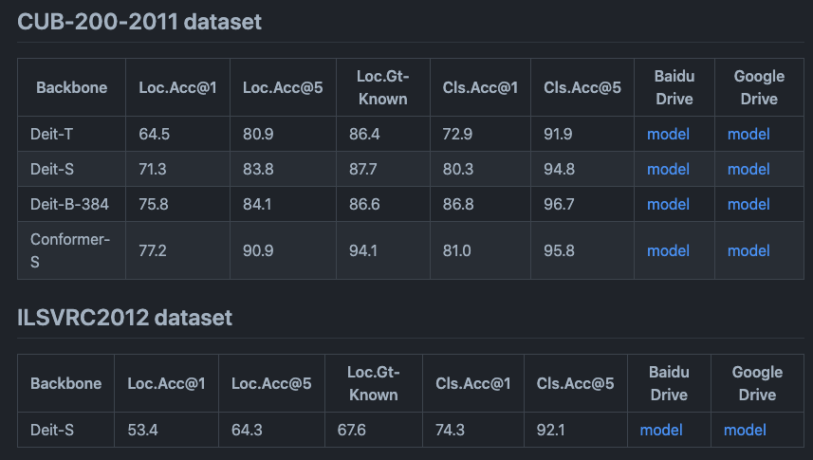
TS-CAM: Token Semantic Coupled Attention Map for Weakly Supervised Object Localization
https://github.com/vasgaowei/TS-CAM

Slide 18
ECCV 2020 Tutorial on Weakly-Supervised Learning in Computer Vision
A great resource:
https://hbilen.github.io/wsl-eccv20.github.io/

Slide 19
Weakly Supervised Object Localization and Detection: A Survey, Zhang et al. 2021
A great review paper:
https://doi.org/10.1109/TPAMI.2021.3074313

Slide 20
Let’s demo 💻
https://github.com/g41903/ObjectLocalization-WeaklySupervised
https://github.com/vasgaowei/TS-CAM/blob/master/tools_cam/visualization_attention_map_imaget.ipynb
https://github.com/yeezhu/SPN.pytorch/blob/master/demo/EvaluationDemo.ipynb

Slide 21
Extra slides

Slide 22
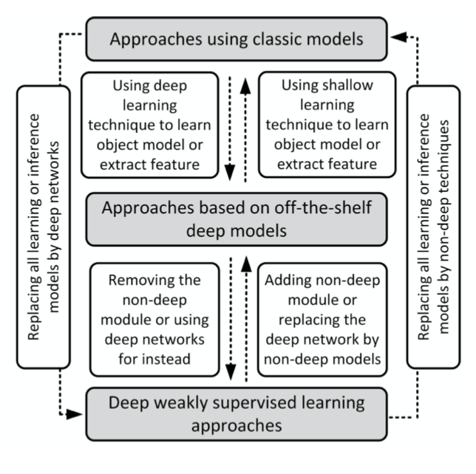
figure credit: Zhang et al. 2021

Slide 23
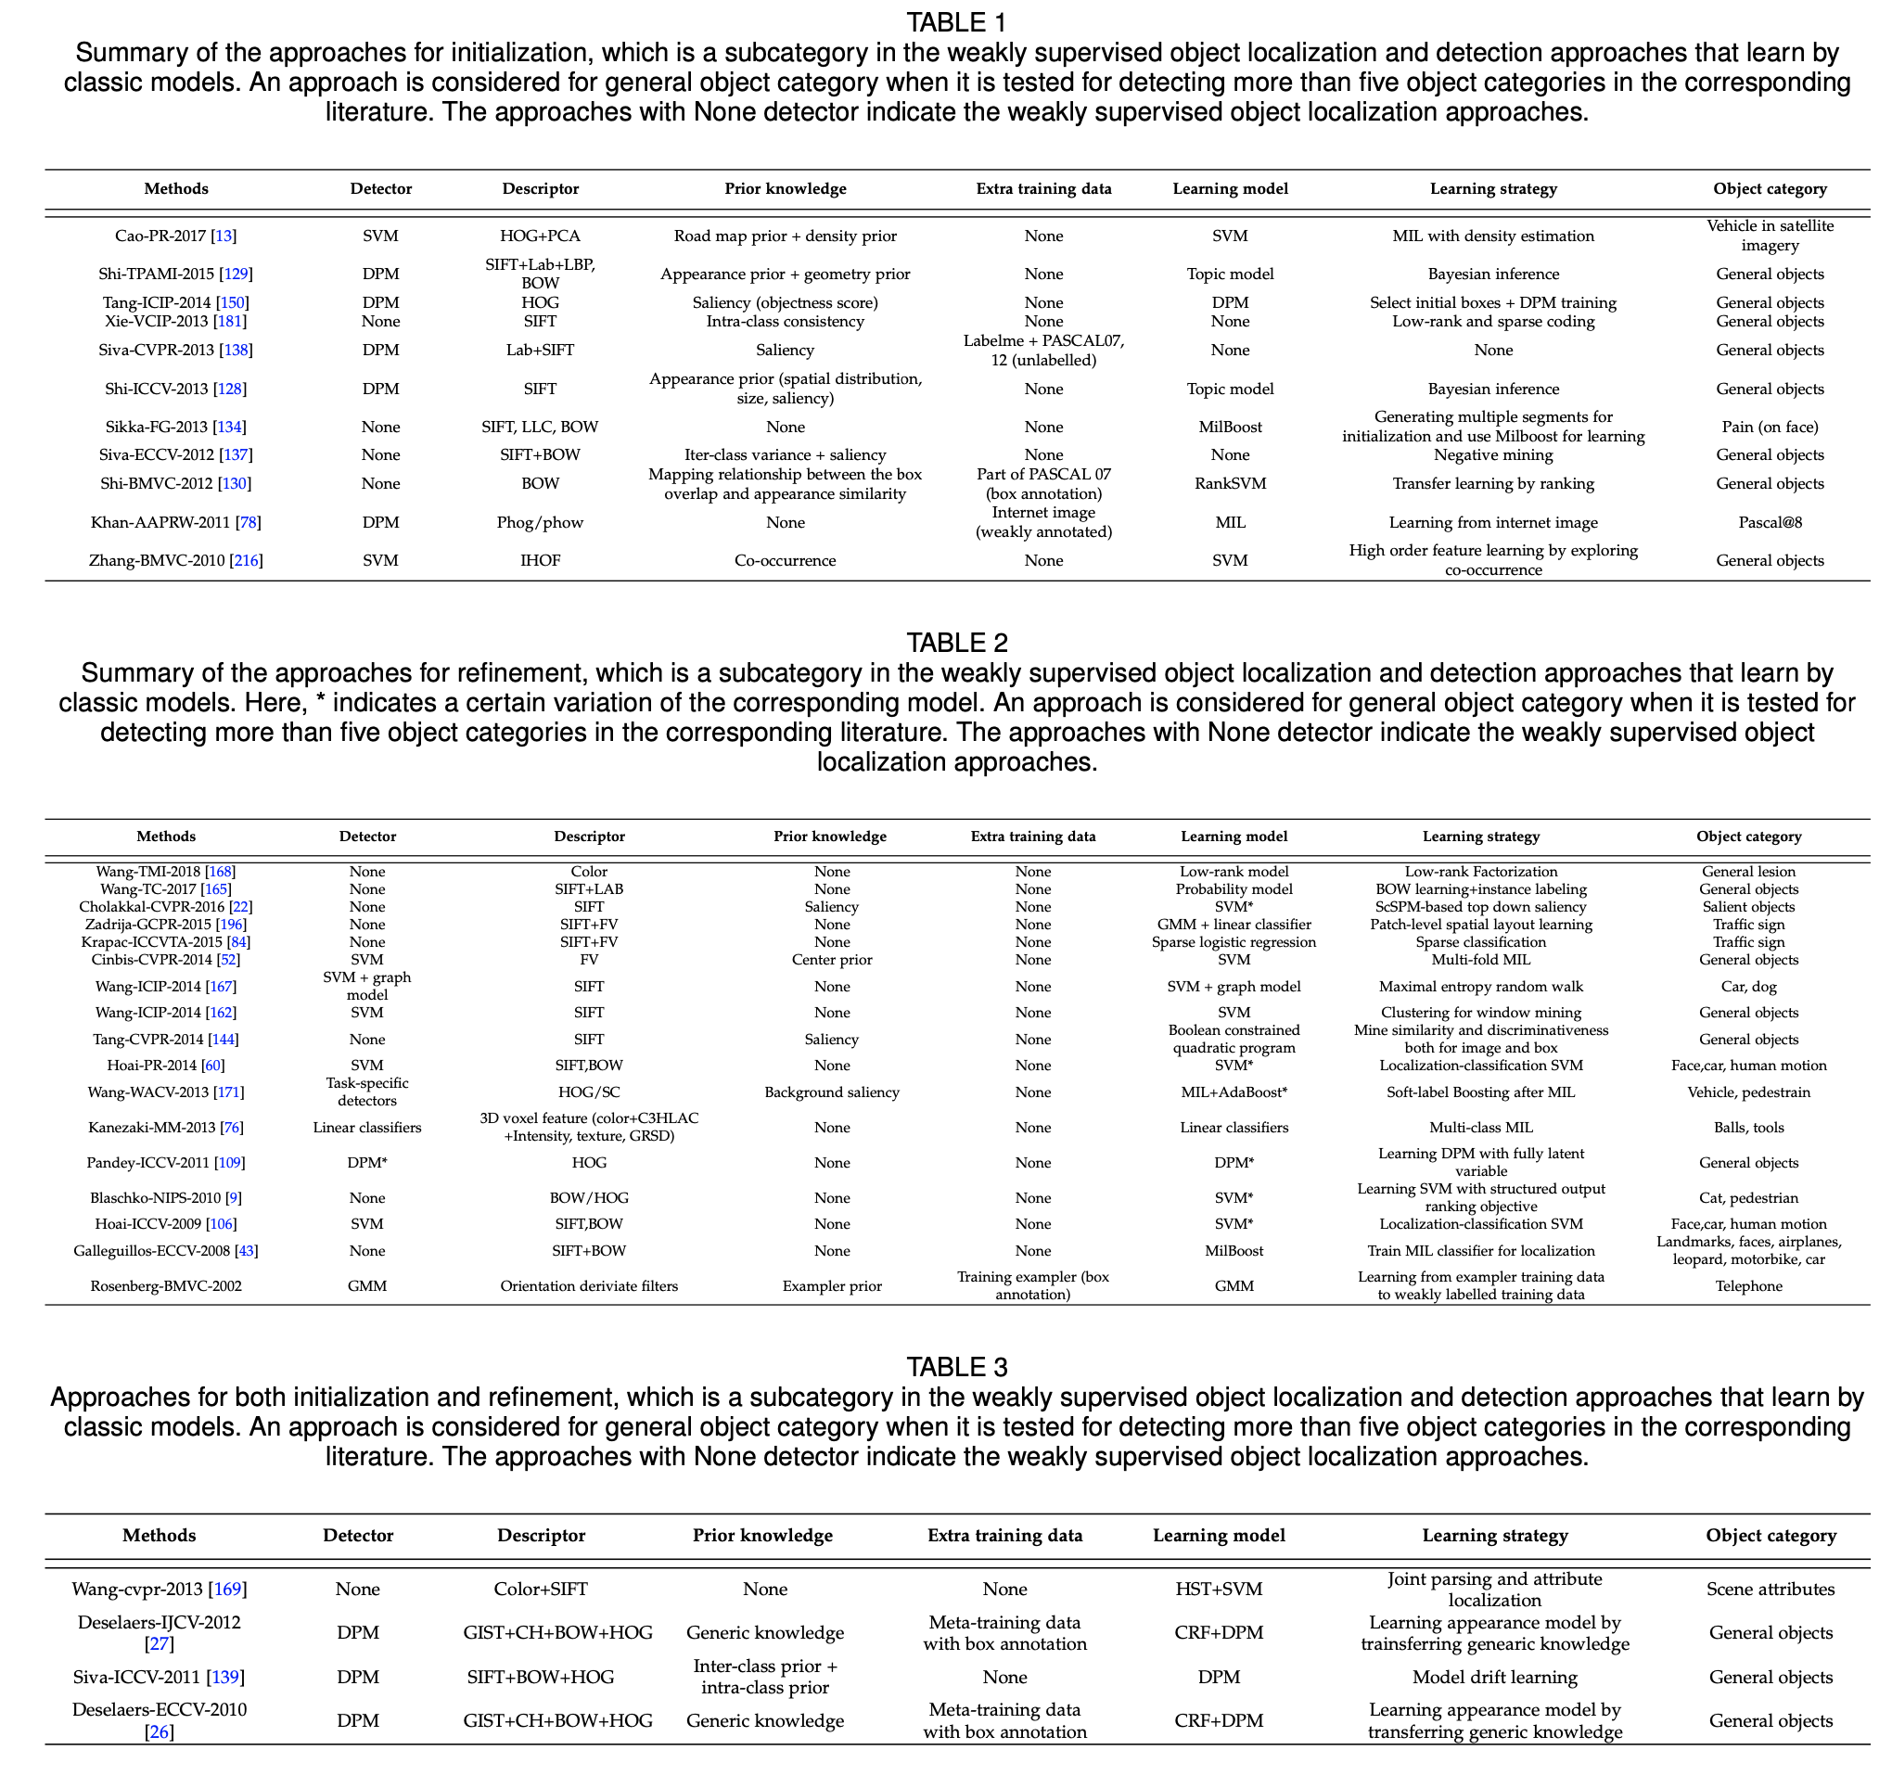
figure credit: Zhang et al. 2021

Slide 24
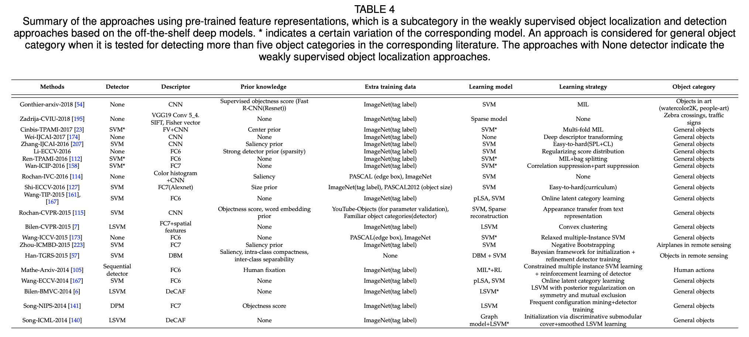
figure credit: Zhang et al. 2021

Slide 25
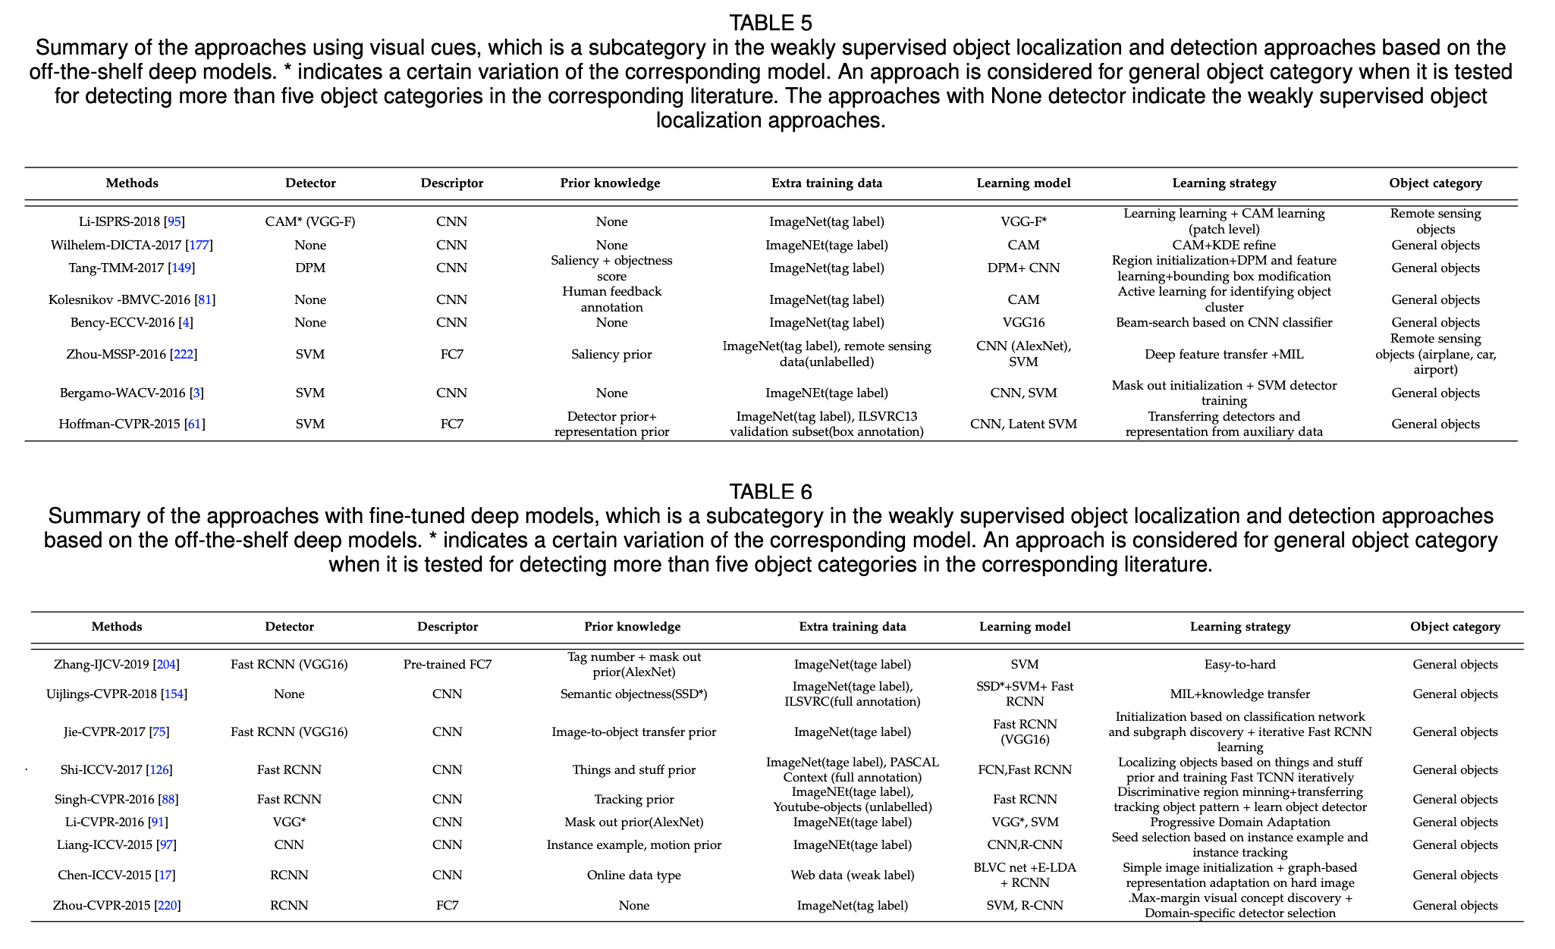
figure credit: Zhang et al. 2021

Slide 26
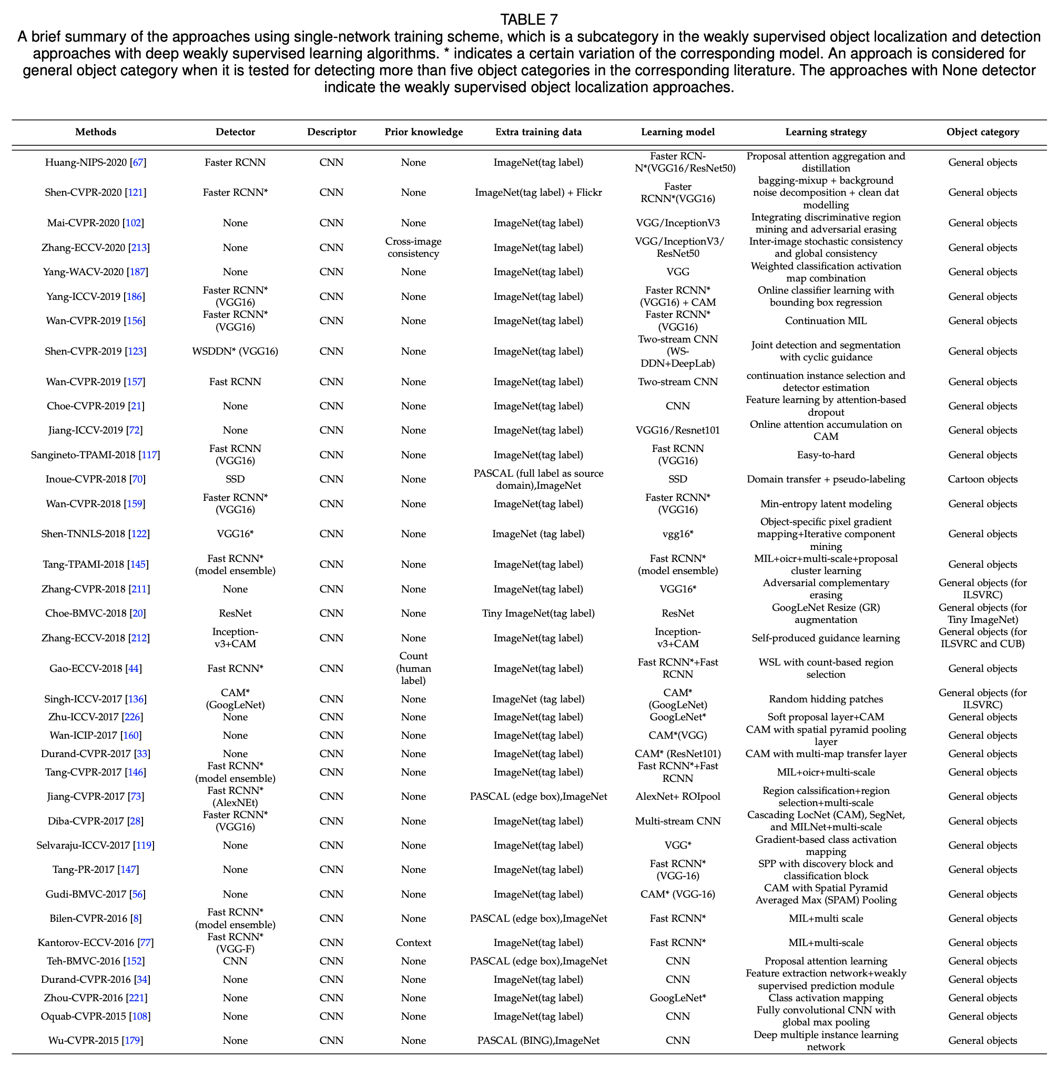
figure credit: Zhang et al. 2021

Slide 27
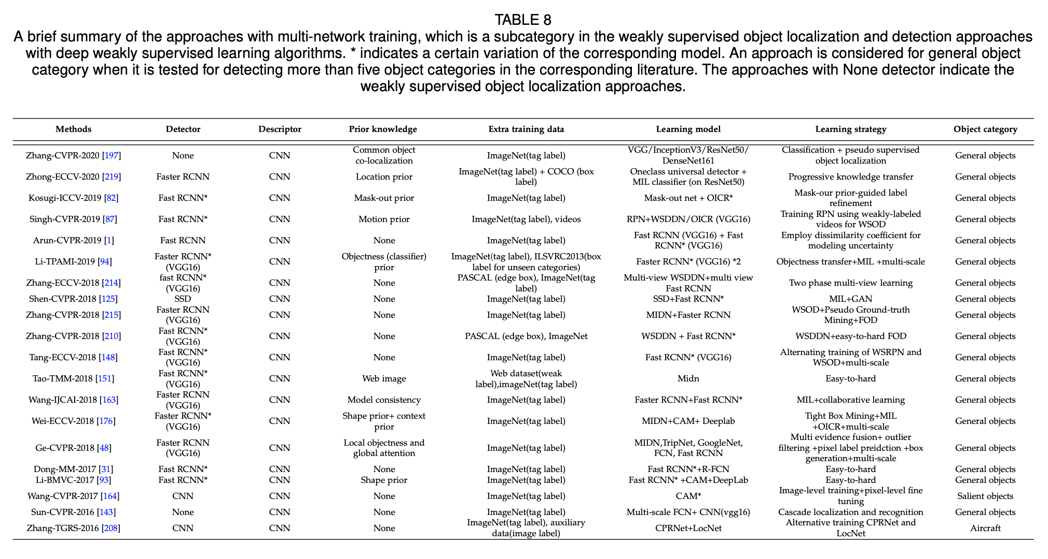
figure credit: Zhang et al. 2021

